Slide 1
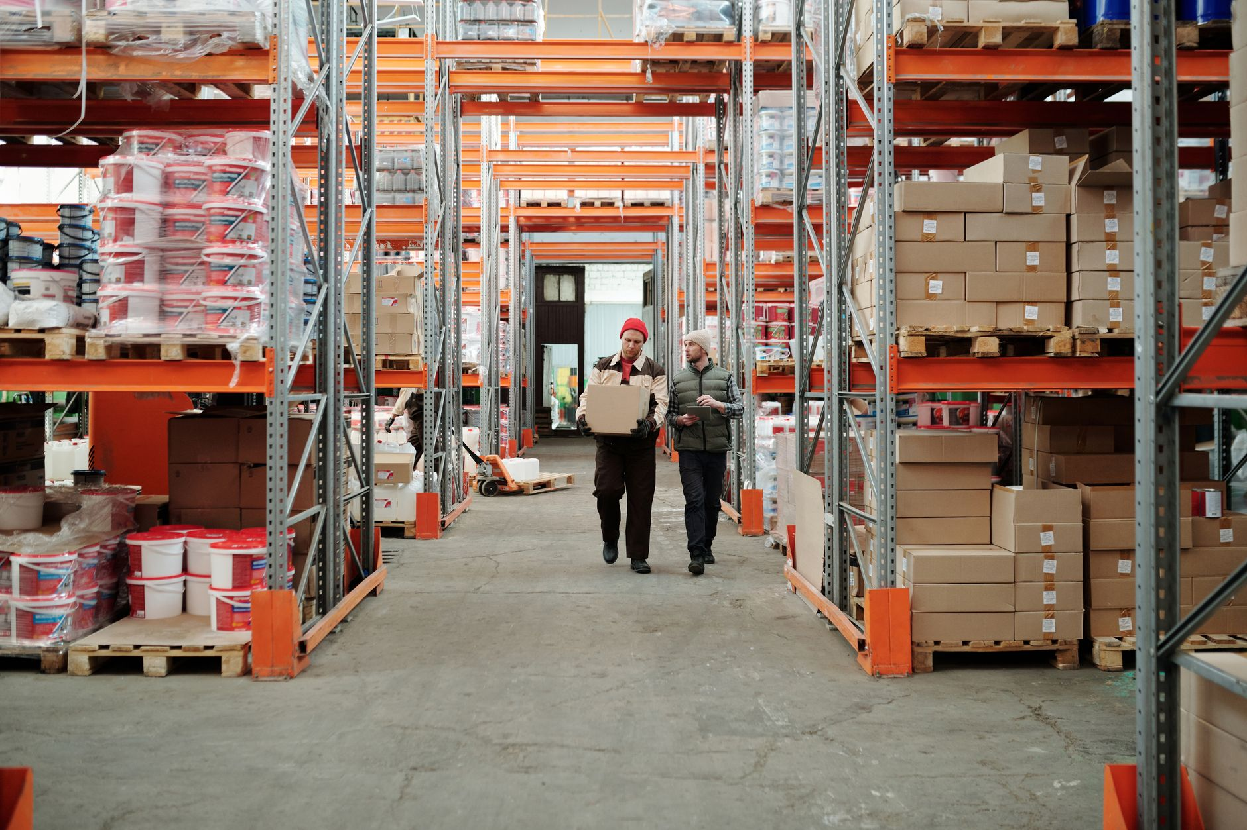
Project Willow Overview
Introducing the 60-day inventory pilot at 8 fictional stores.
Notes:
Introduce the pilot project and its significance.

Slide 2
Pilot Budget and Measurement
$48,000
60 days
Budget Ceiling
Pilot Duration
Notes:
Discuss the budget constraints and measurement strategy.

Slide 3
Delivery Plan Timeline
1
2
3
Weeks 1-2
Weeks 3-6
Weeks 7-8
Record baseline and confirm store owners.
Run replenishment checks.
Review stockouts and report findings.
Notes:
Outline the step-by-step plan for the pilot.

Slide 4
Risks and Mitigation
Incomplete store logs could weaken comparison.
Jordan Vale to review missing entries weekly.
Notes:
Highlight potential risks and mitigation strategies.

Slide 5
Approval Request
Approve the 60-day inventory pilot by November 20, 2026. Contact Jordan Vale for further details.
Notes:
Conclude with the decision request for pilot approval.

